Slide 1
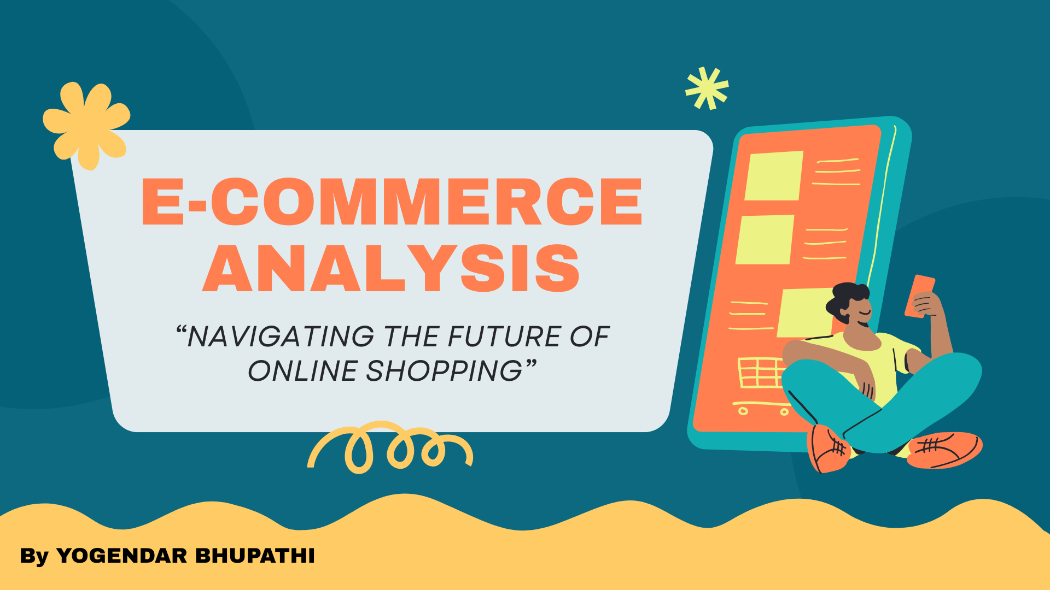

Slide 2

Agenda
Problem Statement
Data Description
Objective Key Metrics and Visualizations
Subjective Question for Insights

Slide 3
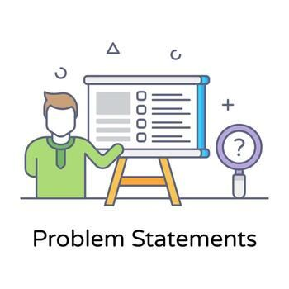
Problem Statement
You are working as a business analyst at Amazon, a company currently performing well. The stakeholders wish to maintain this level of performance and seek improvement. For this purpose, they want to devise new strategies. You are part of a team exploring new ways to benefit customers, such as offering more discounts and Prime membership perks. Could you suggest additional methods to identify and reward customers and enhance their shopping experience?

Slide 4
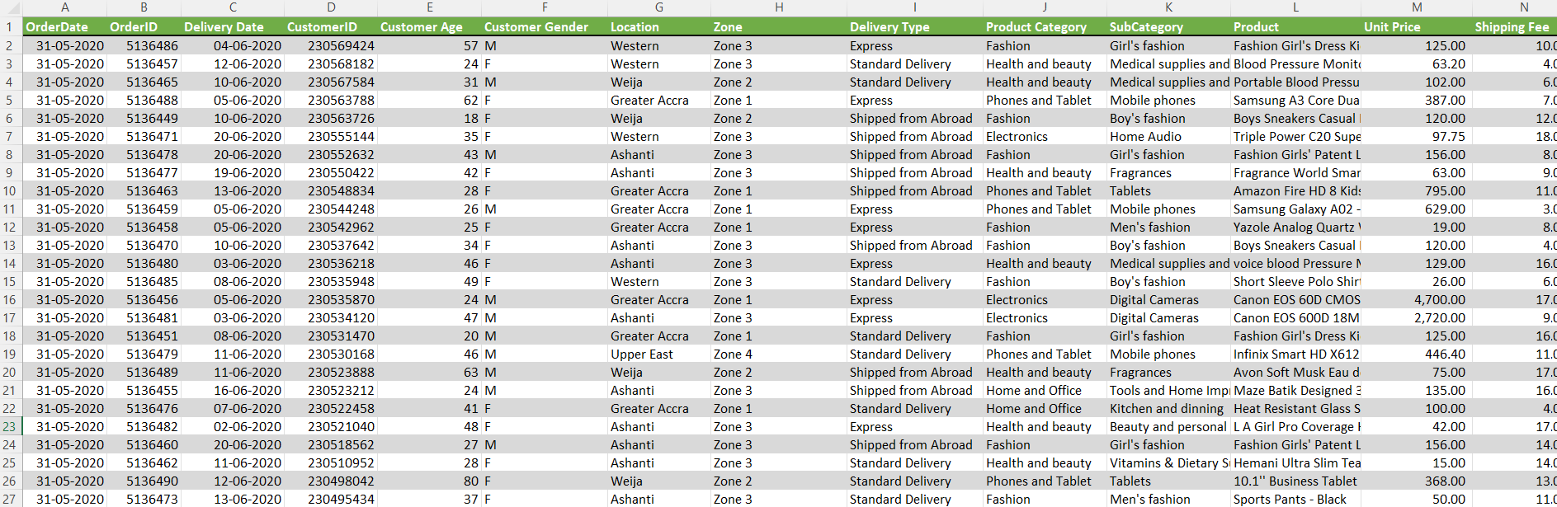
Data Overview
Dataset: Orders and Customers
Dataset size: 1.13 lahk rows

Slide 5
Data Cleaning & Preparation
The data cleaning and preparation process was carried out to ensure accuracy, consistency, and reliability of the dataset before analysis. Missing values and empty records were identified and removed to avoid incorrect results. Data types were standardized across columns such as dates, numerical values, and categorical fields to support proper calculations and visualizations. Unnecessary and duplicate columns were removed, and column names were renamed for better clarity and understanding. Rows containing invalid or irrelevant data were filtered out to maintain data quality. Additional conditional columns were created to support customer segmentation and analytical requirements. Column order was reorganized to improve structure and readability of the dataset. Relationships between tables were validated using CustomerID to ensure accurate data modeling. Overall, these steps transformed the raw data into a clean, structured, and analysis-ready dataset suitable for building reliable Power BI dashboards and generating meaningful business insights.

Slide 6
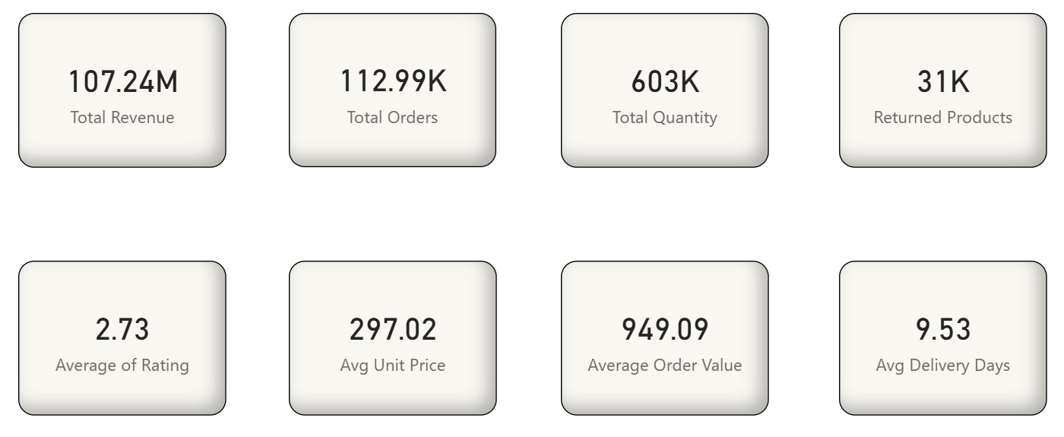
Key Metrics

Slide 7
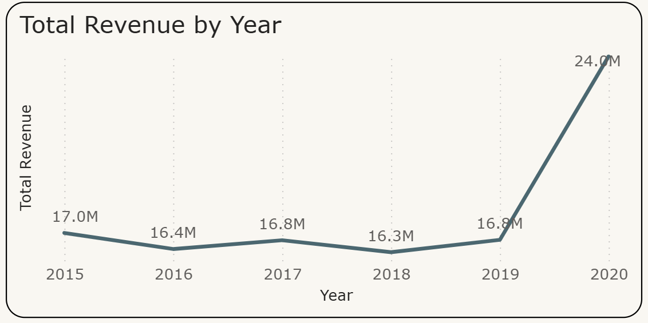
Total Revenue by Year
The revenue remained relatively stable between 2015 and 2019, fluctuating around the 16M–17M range without significant growth.
The most significant change occurred in 2020, where revenue sharply increased to 24M, marking the highest revenue recorded in the given period.
The strong jump in 2020 suggests improved sales strategy, higher customer demand, better product performance, or expanded market reach.
Overall, the company maintained stable performance for five years and achieved substantial growth in the final year, indicating strong potential for future expansion.

Slide 8
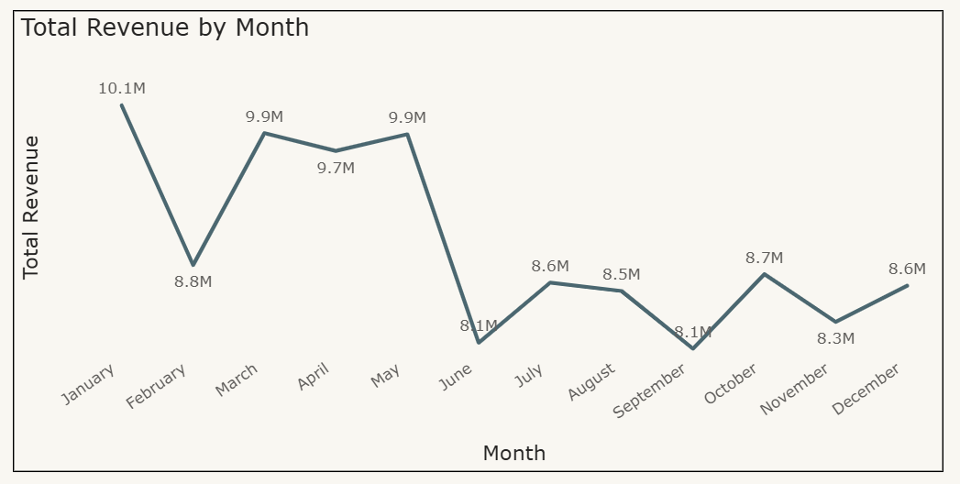
Total Revenue by Month
Revenue is highest in January (10.1M), indicating strong sales at the beginning of the year.
A noticeable drop occurs in February, suggesting seasonal variation or lower demand.
A significant drop is observed in June (8.1M), showing a mid-year slowdown.
Sales remain relatively stable between March and May, maintaining consistent performance.
Revenue slightly improves toward the end of the year, especially in October and December, suggesting seasonal demand impact.

Slide 9
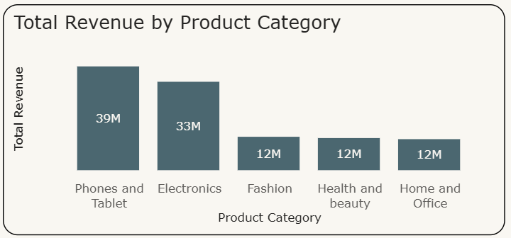
Total Revenue by Product Category
The Phones and Tablet category generates the highest revenue at 39M, making it the top-performing category for the company.
Electronics follows closely with 33M in revenue, indicating strong customer demand in technology related products.
The remaining categories — Fashion, Health and Beauty, and Home and Office — each generate 12M, significantly lower compared to the top two categories.
Lower-performing categories present an opportunity for growth through targeted marketing, discounts, product bundling, and improved customer engagement strategies.

Slide 10
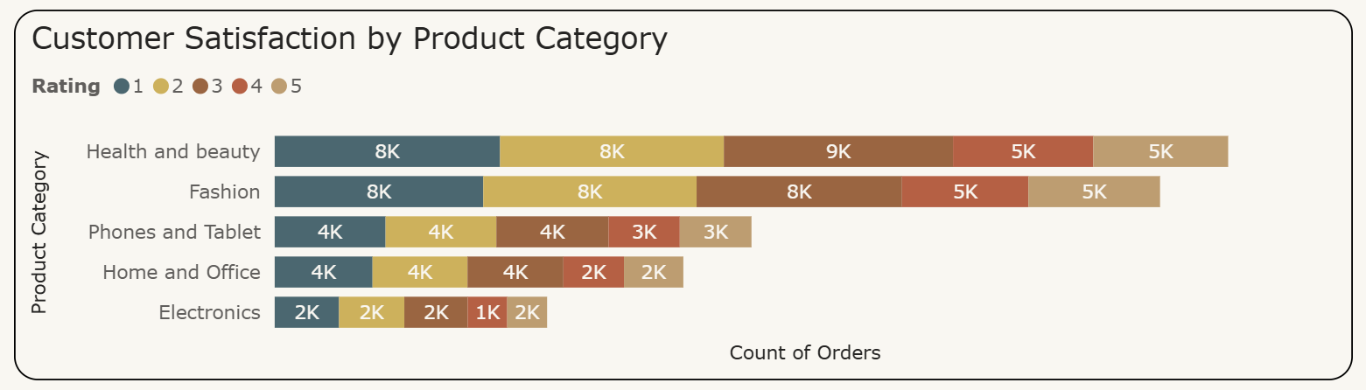
Customer Rating by Product Category
Health & Beauty and Fashion categories have the highest number of customer ratings, indicating strong customer engagement and usage.
Phones & Tablets and Home & Office show moderate satisfaction levels, suggesting stable but comparatively lower customer interaction.
Electronics category has the lowest rating count, which may indicate lower demand or fewer customer reviews.
Overall, most ratings fall in the mid-to-high range, showing generally positive customer satisfaction across categories.

Slide 11
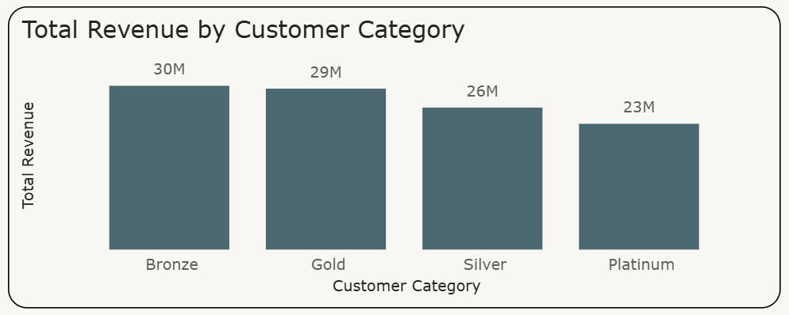
Total Revenue by Customer Category
Bronze customers generate the highest revenue (30M), mainly because they represent the largest customer base (87K customers).
Although Gold and Platinum have fewer customers (7K and 3K), they still contribute significant revenue, indicating higher spending per customer.
Silver customers (15K) contribute moderate revenue (26M), suggesting stable but not premium spending behavior.
This shows that Bronze drives revenue through volume, while Gold and Platinum drive revenue through higher individual purchase value, making both segments strategically important.

Slide 12
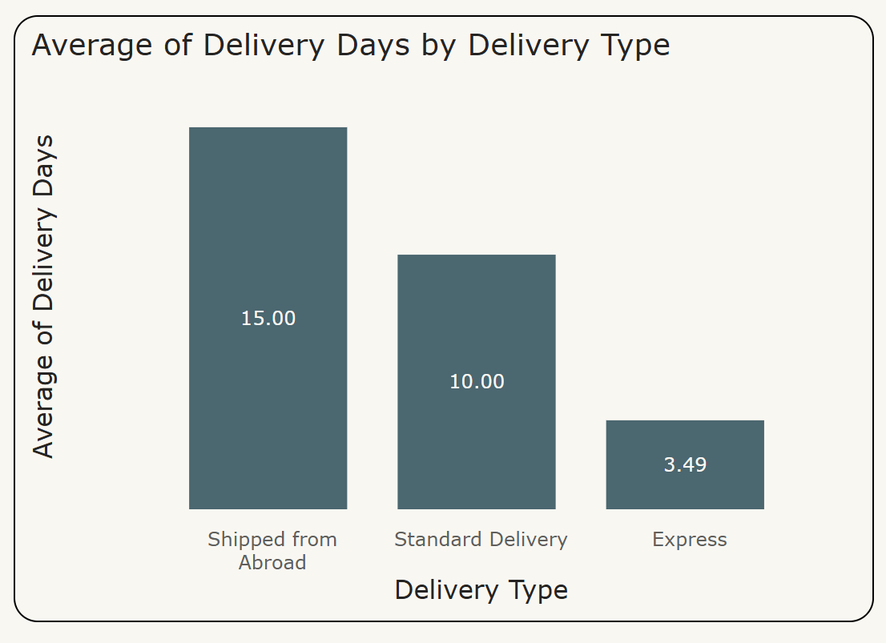
Average Delivery Days by Delivery Type
Orders shipped from abroad take the longest time (15 days), which may affect customer satisfaction due to delayed delivery.
Standard delivery takes around 10 days, offering a balanced option between cost and delivery time.
Express delivery is the fastest (around 3.5 days), making it the preferred option for urgent purchases.
Improving international logistics and promoting express delivery options can help enhance overall customer experience.

Slide 13
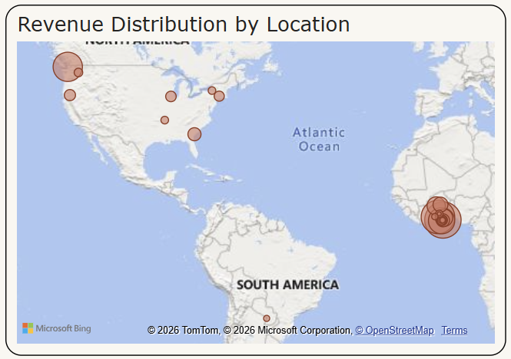
Revenue Distribution by Location
Greater Accra and Ashanti generate the highest revenue, indicating these regions are key contributors to overall sales performance.
Western and Weija show moderate revenue contribution, suggesting steady demand but with potential for further growth.
Upper West records the lowest revenue among the top locations, highlighting an opportunity for targeted marketing and expansion.
The visualization shows revenue is concentrated in specific regions, especially in Africa, indicating strong regional demand and market presence.

Slide 14
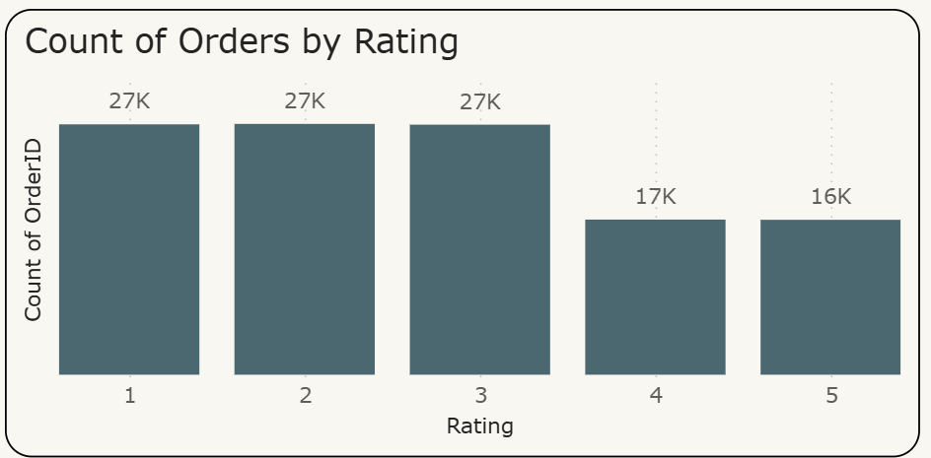
Count of Orders by Rating
Most orders fall under ratings 1, 2, and 3, indicating a large portion of customers are giving average or low satisfaction scores.
Higher ratings (4 and 5) have fewer orders, suggesting comparatively lower customer satisfaction levels.
The drop from rating 3 to 4 and 5 highlights a gap in positive customer experience.
Improving product quality, delivery time, and service can help increase higher ratings and overall customer satisfaction.

Slide 15

Reports

Slide 16
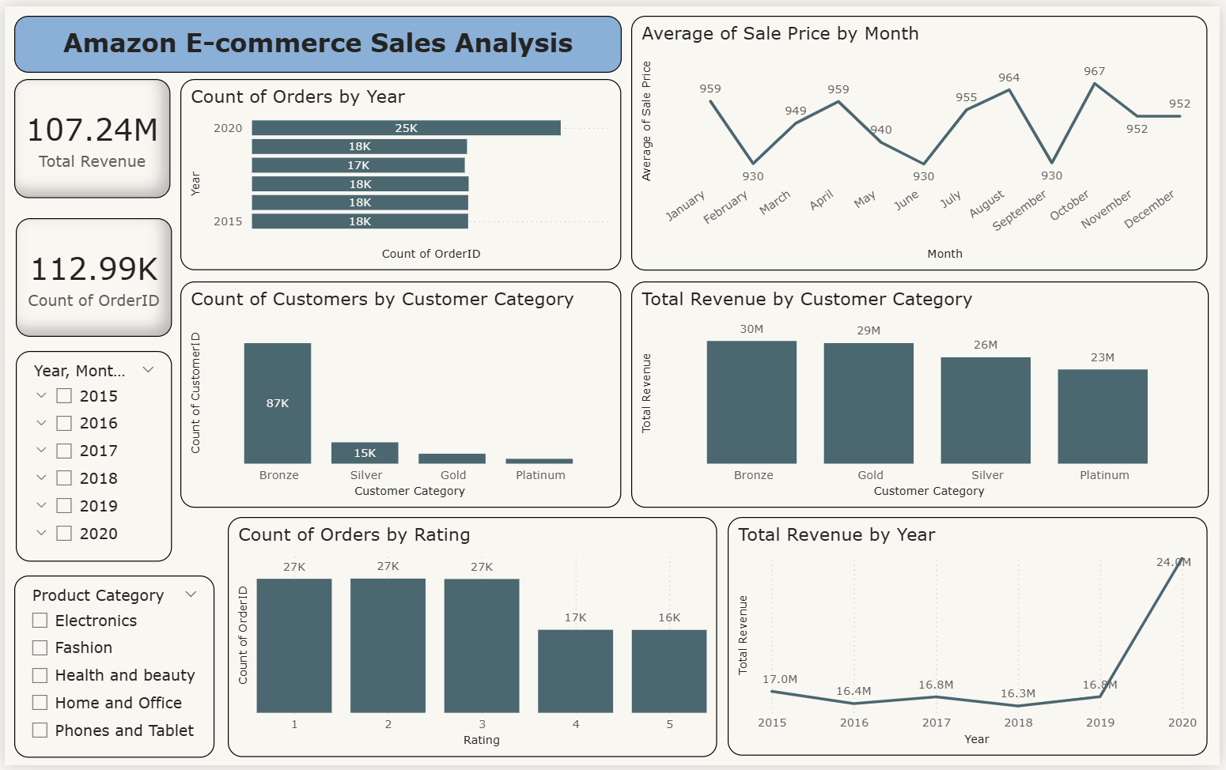

Slide 17
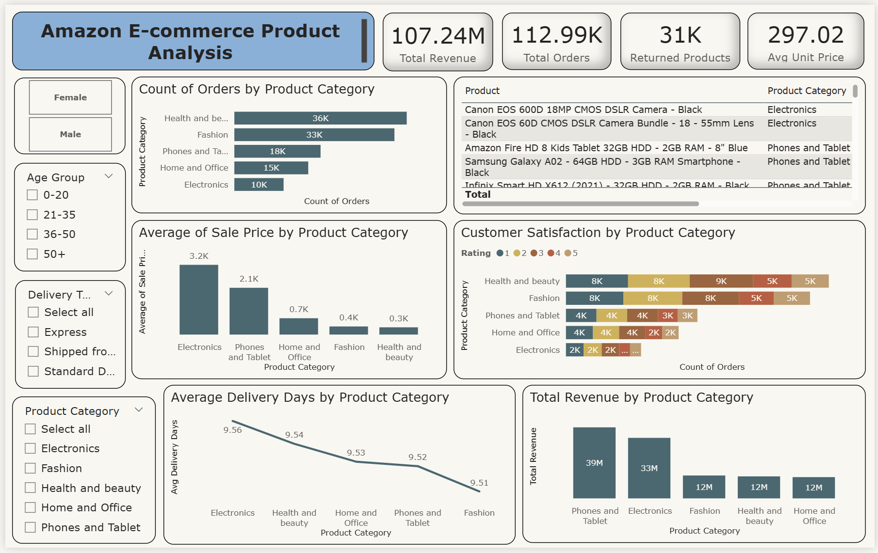

Slide 18
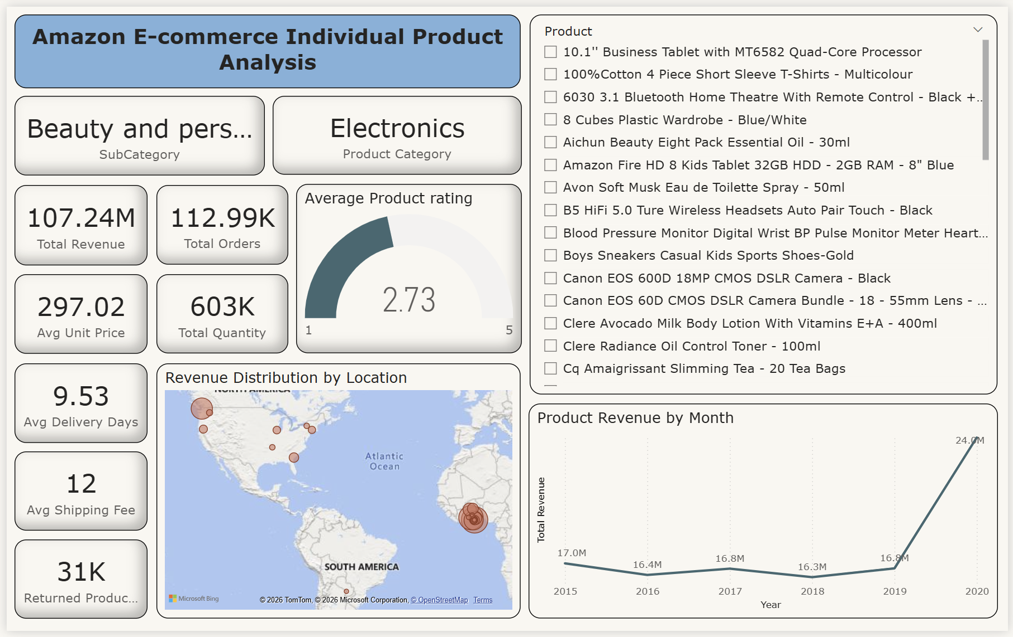

Slide 19
Strategic Recommendations
Focus on high-performing categories like Phones, Tablets, and Electronics by maintaining inventory, competitive pricing, and targeted promotions to maximize revenue.
Improve low-performing categories such as Fashion, Home & Office, and Health & Beauty through discounts, better product visibility, and personalized marketing campaigns.
Enhance customer satisfaction by addressing product quality issues, improving delivery timelines, and strengthening after-sales support.
Promote Express delivery options and optimize international shipping processes to reduce delivery time and improve customer experience.
Implement loyalty programs and personalized offers for Bronze, repeat customers to increase retention and lifetime value.
Expand operations in high-revenue locations and strengthen marketing efforts in low-performing regions to balance geographic sales distribution.
Use customer feedback and ratings to continuously improve product offerings and service quality.
Leverage data-driven decision-making to identify trends, predict demand, and optimize pricing and promotional strategies.

Slide 20


